Slide 1

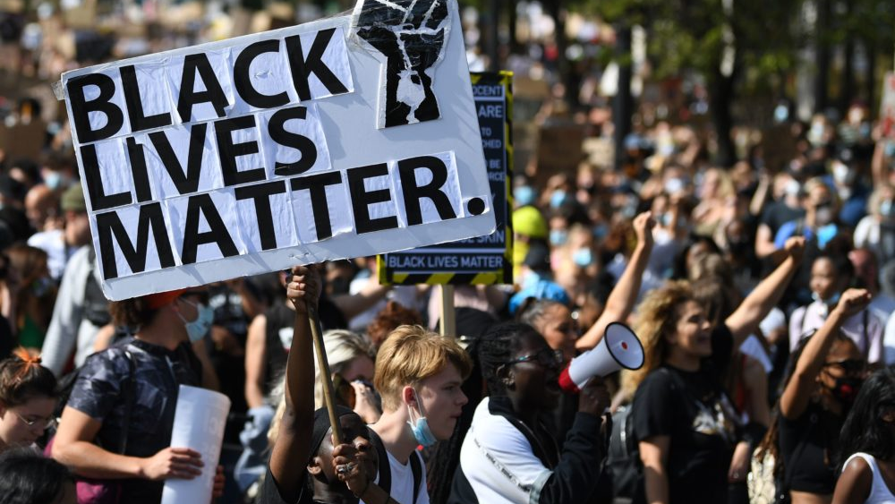
REPLICATION STUDY SAMANTA NEDZINSKAITE
“Black Lives Matter for Whites’ Racial Prejudice: Assessing the Role of Social Movements in Shaping Racial Attitudes in the United States” (2019)
Soumyajit (Shom) Mazumder

Slide 2
Contents
The Original Study
01
My Contribution
02
Findings
03
Assessing the Models +
Conclusion
04

Slide 3
The Original Study: Abstract
Black Lives Matter (BLM) is a modern mass social movement in the US, prominent for its use of protests.
Its aim is to deconstruct systematic racism in the US, but it is yet unclear if BLM has led to more liberal attitudes towards race amongst whites.
The author used data from over 140,000 survey respondents and BLM protest locations in 2014 to investigate this question.
The results show that BLM protests reduced racial prejudice among white people (with younger whites being more affected than older ones). This study suggests that protests can drive attitude change.

Slide 4
The Original Study: Data
Response Variables:
affirm:
1 if respondent supports affirmative action
0 otherwise
dem:
1 if respondent identifies with the Democratic party (including leaners)
0 otherwise
resent:
disagreement on a 5-point scale with the “Generations of slavery” question, and agreement with the “The Irish, Italians, and Jews” question)

Slide 5
Predictor Variables:
protest_indicator: indicator for whether there were any protests in a county
Pctblack:
The percent of the population that is black in 1960
Pcturban:
The percent of the population that is black in 1960
logTotPop1960:
The percent of the population that is black in 1960
avg.dem.vshare.pre Average Democratic Party vote share in a given county from 1932-1960
Medincome:
The percent of the population that is black in 1960
state.abb:
state abbreviations

Slide 6
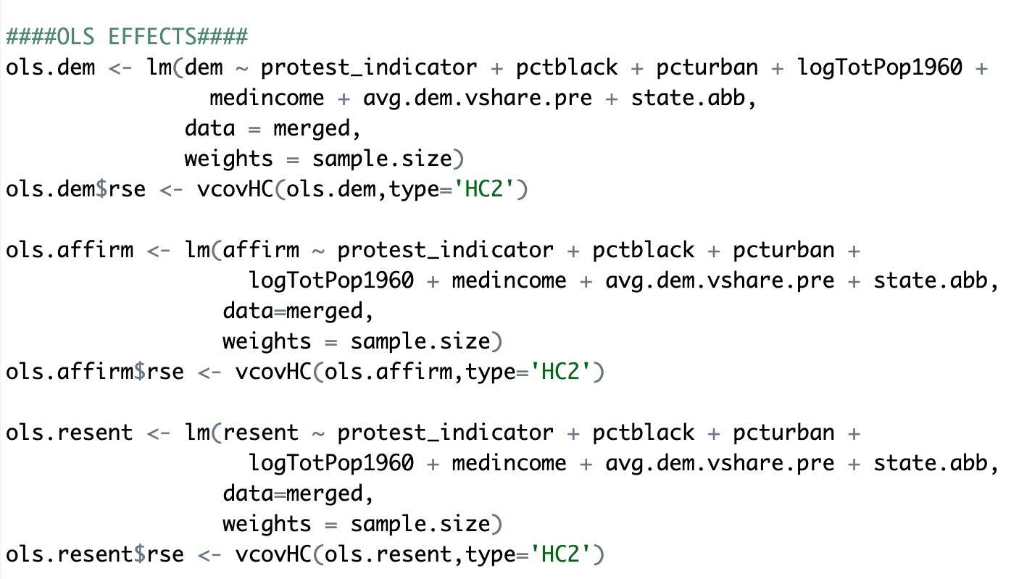
The Original Study: Statistical Analysis
The author performs an Ordinary Least Squares (OLS) regression analysis on three outcome variables: "dem", "affirm", and "resent". These variables in conjunction represent different attitudes towards BLM protests.
The regression being performed is an additive linear regression. The outcome variables are being modelled as a linear combination of the independent variables, with the coefficients representing the additive effects of each independent variable on the outcome

Slide 7
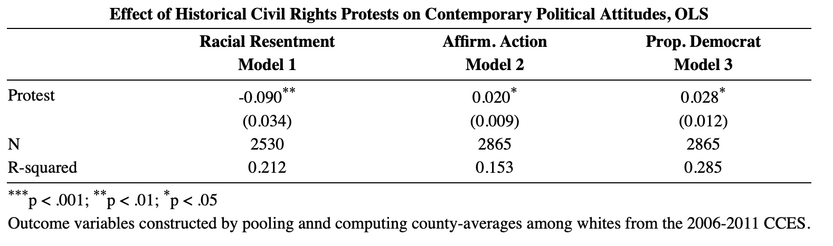
The Original Study: Findings
The author conducted an additive regression analysis examining the relationship between historical civil rights protests and contemporary political attitudes, specifically racial resentment, affirmative action, and proportion of Democrat voters.
The results indicate that protests have a statistically significant negative effect on racial resentment and a statistically significant positive effect on affirmative action and proportion of Democrat voters.

Slide 8
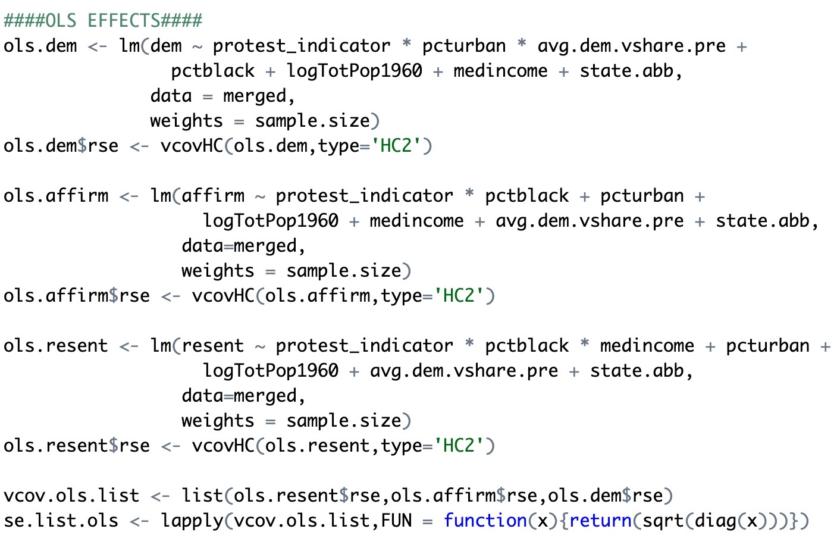
My Contribution: Statistical Analysis
My replication analysis is performing linear regression analysis on three outcome variables: "dem", "affirm", and "resent", just like the original study. However, in my replication, the regression includes an interaction term between some of the independent variables and the "protest_indicator" variable.

Slide 9
My Contribution: Statistical Analysis
My replication uses interaction terms because I anticipate that the relationship between some of the independent variables and the outcome variables is not additive.
In interactive regression, the impact of an independent variable on the outcome variable is not fixed. It can change based on the values of other independent variables. This means that the effect of each independent variable on the outcome is not simply additive.

Slide 10
Justifying Regression with Interaction (1/3)
It is possible that the effect of protests on support for the Democratic party ("dem") may depend on the percentage of urban population or the average Democratic vote share in the county.
Social identity theory: Protests may activate people's sense of social identity as members of a particular group (such as urban residents or Democrats).
Social identity theory suggests that people tend to favor and support members of their own group & might engage in inter-group competition with members of other groups.
Thus, the effect of protests on support for the Democratic party may be stronger in urban areas where people are more likely to identify with the Democratic party and its values.

Slide 11
Justifying Regression with Interaction (2/3)
It is possible that the effect of protests on attitudes towards affirmative action policies ("affirm") may depend on the percentage of Black population in the county .
Group threat theory: when individuals perceive a threat to their group's social, economic, or political status, they are more likely to oppose policies that benefit members of other groups.
Particularly relevant when it comes to affirmative action policies (benefiting minority groups at the expense of majority groups).
In counties with a higher Black population, white individuals may perceive a greater threat to their group's status, leading to more opposition to affirmative action policies.
However, if BLM protests in those counties are successful in drawing attention to issues of systemic racism and inequality, they may increase awareness of the need for policies such as affirmative action, ultimately leading to more support among white individuals.

Slide 12
Justifying Regression with Interaction (3/3)
It is possible that the effect of protests on resentment towards African Americans ("resent") may depend on the percentage of Black population or the level of median income.
The intergroup relations theory: people's attitudes towards members of other groups are influenced by their perceptions of the social and economic status of those groups.
When members of a low-status group (such as African Americans) protest for greater social and economic equality, it may be seen as a challenge to the status quo & a threat to the interests of the dominant group.
The effect of protests on resentment towards African Americans may therefore be stronger in areas with a higher percentage of Black population, where the perceived threat to the dominant group is greater.

Slide 13
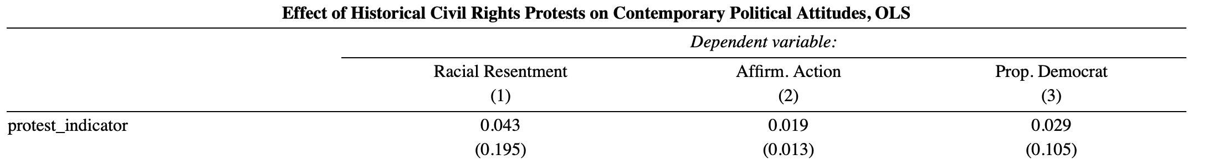
My Contributon: Findings
The original study, which used additive linear regression, found that for every one-unit increase in the protest indicator, the level of racial resentment decreases by 0.090 units on average, and this result was statistically significant at the 1% level.
In my replication with interactions, the coefficient for the protest_indicator is 0.043 and not statistically significant, which means that there is no evidence to suggest that the protest_indicator has a significant impact on racial resentment when controlling for other variables in the model.
In practical terms, this means that the effect of protest on racial resentment may not be as straightforward as previously thought, and that other factors not included in the model may play a more significant role in shaping racial resentment.

Slide 14
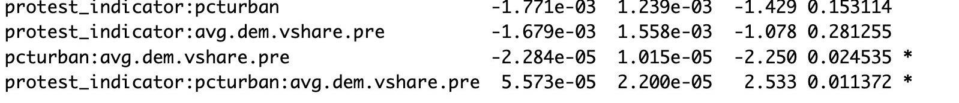
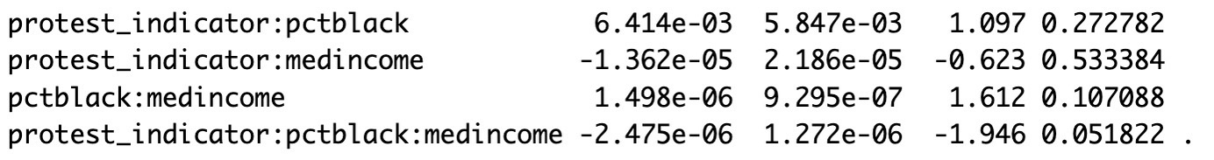
My Contribution: Findings

Slide 15
My Contribution: Findings
The most telling coefficient in this output is the interaction between protest_indicator, pcturban, and avg.dem.vshare.pre, with a coefficient of 5.573e-05 and a significant p-value of 0.011372. This suggests that the effect of protests on the Democratic vote proportion is influenced by both the urbanization level and the pre-protest level of Democratic support. Specifically, the effect of protests on the Democratic vote proportion is stronger in urban areas with higher pre-protest levels of Democratic support.
For every one-unit increase in protest_indicator, one-unit increase in pcturban, and one-unit increase in avg.dem.vshare.pre, there is an estimated 0.00005573 increase in the Democratic vote proportion.

Slide 16
My Contribution: Findings
The interaction coefficient for protest_indicator:pctblack is 1.340e-04, which is not statistically significant (p=0.76), indicating that the relationship between affirmative action support and protest activity is not significantly moderated by the percentage of Black individuals in the population.
In practical terms, this means that the relationship between protest activity and affirmative action support is similar across areas with different percentages of Black individuals.

Slide 17
My Contribution: Findings
The coefficient for the three-way interaction between protest_indicator, pctblack, and medincome suggests that there is a negative relationship between these variables and racial resentment, but this relationship is marginally significant at the p < 0.10 level. This means that the interaction term may be playing a small role in explaining the variation in racial resentment, but the evidence for this is not strong.
It would be premature to conclude that as income level, population of black people and the presence of BLM protests increase, racial resentment decreases. Further research would be needed to fully understand the relationship between these variables and racial resentment.

Slide 18
Assessing the Models
 | Additive Regression | Interaction Regression
dem.ols | 0.2851695 | 0.2955457
affirm.ols | 0.1531063 | 0.1531348
resent.ols | 0.2115236 | 0.2140825
Difference between the R-squared values of the two models.
The differences between the R-squared values of the two models are only marginally different. This would allow us to conclude that adding interactions to the regression did not improve or worsen the proportion of variance in the outcome variable that is explained by the predictors in the model.

Slide 19
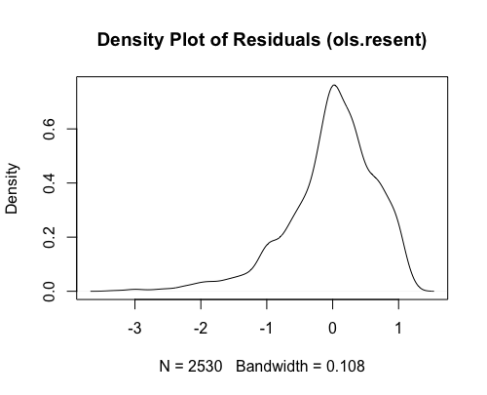
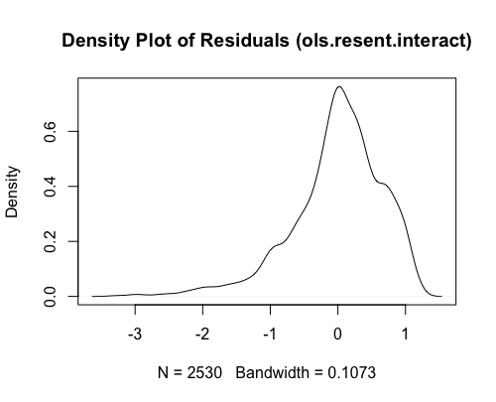
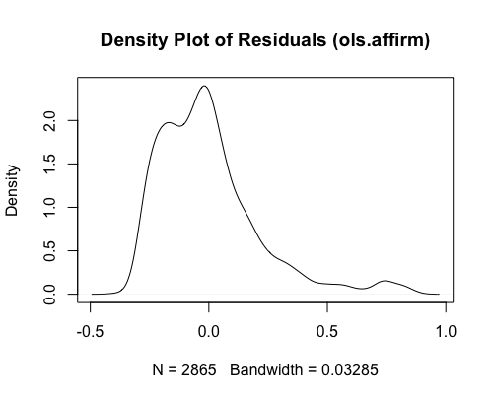
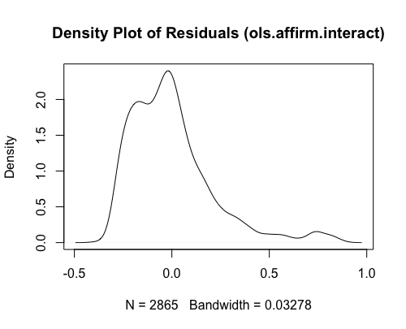
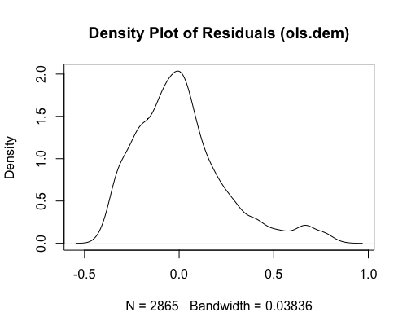
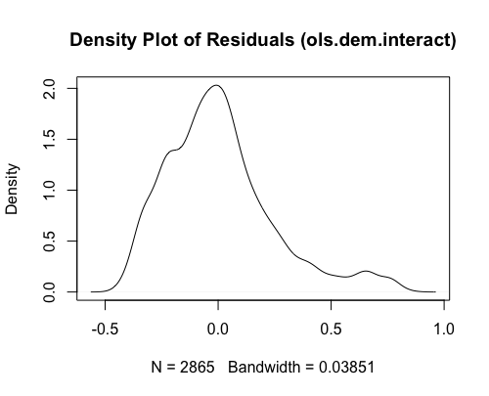
Assessing the Models
The long left tail of the residuals in ols.resent suggests that the model may be underestimating the variation in racial resentment for some observations.
The long right tail of the residuals in ols.affirm and ols.dem suggests that the model may be overestimating the variation in affirmative action support and for democratic vote share for some observations.
There is very little difference in the density plots of residuals for both the additive and the interactive regression, contributing to the idea that both models performed similarly.
Overall, these findings suggest that the models may not be fully adequate in capturing the complexity of the relationship between the dependent and independent variables.
Further research may be necessary to better understand the factors that contribute to racial resentment and affirmative action support.

Slide 20
Conclusion
Overall, the results suggest that the relationship between protest activity and racial resentment may not be as straightforward as previously thought.
The interaction between protest_indicator, pcturban, and avg.dem.vshare.pre suggests that the effect of protests on the Democratic vote proportion is stronger in urban areas with higher pre-protest levels of Democratic support.
The lack of significance in the protest_indicator:pctblack interaction suggests that the relationship between protest activity and affirmative action support is similar across areas with different percentages of Black individuals.
The marginally significant three-way interaction suggests that income level and population of Black individuals may play a small role in explaining variation in racial resentment, but further research is needed to fully understand this relationship.
In practical terms, this means that other factors not included in the model may play a more significant role in shaping racial resentment. These findings have important implications for the original study and suggest that a more nuanced understanding of the relationship between protest activity and racial attitudes is needed.

Slide 21
Bibliography
Original Study:
Mazumder, S, 2018. Replication Data for: The Persistent Effect of U.S. Civil Rights Protests on Political Attitudes, https://doi.org/10.7910/DVN/WKJJ3Z/2ZPGEF, Harvard Dataverse, V1.
On Social Identity Theory:
Tajfel, H. and Turner, J.C., 2004. The social identity theory of intergroup behavior. In Political psychology (pp. 276-293). Psychology Press.
On Group Threat Theory:
Stephan, W.G. and Stephan, C.W., 1985. Intergroup anxiety. Journal of social issues, 41(3), pp.157-175.
On Intergroup Relations Theory:
Tajfel, H., 1982. Social psychology of intergroup relations. Annual review of psychology, 33(1), pp.1-39.

Slide 22

THE END. THANK YOU

